Slide 1
DATA ANALYSIS AND VISUALISATION
CSE2015
ANALYSIS OF HEART DISEASES USING MACHINE LEARNING .
PROJECT REVIEW -1

Slide 2
MY TEAM MEMBERS
NAME | ROLL NUMBER
M.ADHARSH | 20211ISD0018
K.VISHNU VARDHAN | 20211ISD0021
JATHIN.B.S | 20211ISD0031
ABHAY R ACHARYA | 20211ISD0023

Slide 3
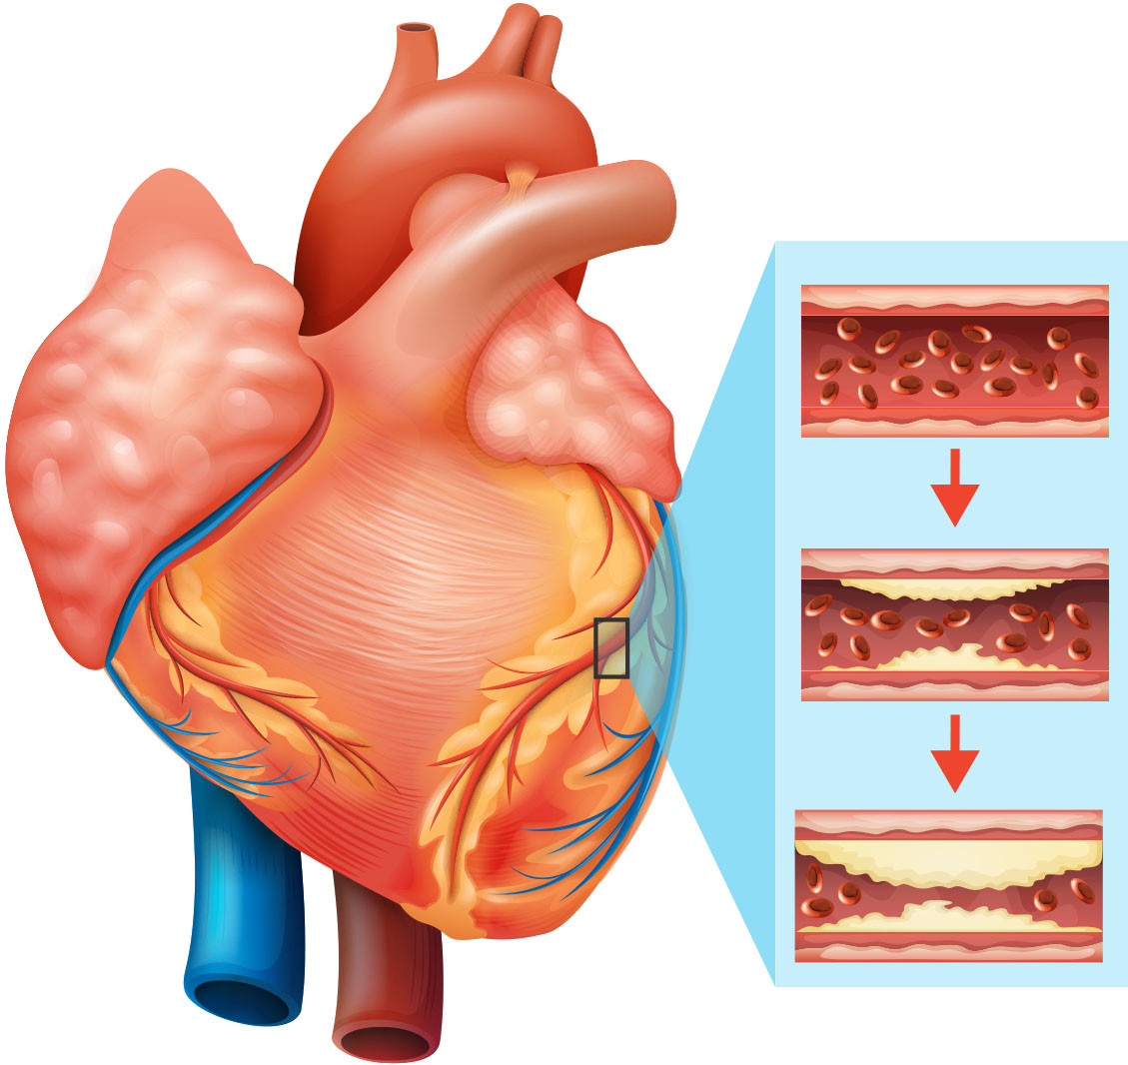
AGENDA :-
Introduction
Tools Used and libraries
Algorithms
Graph
Implementation
Summary
conclusion

Slide 4
INTRODUCTION :-
Heart disease encompasses a range of conditions affecting the heart's functionality and structure, posing significant health risks worldwide. It includes coronary artery disease, heart failure, arrhythmias, and congenital heart defects. Lifestyle factors like high blood pressure, cholesterol, smoking, and obesity contribute to its development. Early detection and management through lifestyle changes, medications, and interventions are crucial for better outcomes.

Slide 5
TOOLS USED :-
Software:
Google Colab: Colaboratory allows us to write and execute Python codes in our browser.
Libraries:
NumPy
Pandas
Seaborn
Matplotlib
Database: Heart disease across the Globe

Slide 6
ALGORITHMS :-
Machine Learning algorithms.
Support Vector Classifier.
Decision Tree Classifier.
Random Forest Classifier.

Slide 7
Machine Learning algorithms
Using machine learning to classify cardiovascular disease occurrence can help diagnosticians reduce misdiagnosis. This research develops a model that can correctly predict cardiovascular diseases to reduce the fatality caused by cardiovascular diseases.

Slide 8
ALGORITHMS :-
KNN Classifier
Support vector machine
Random Forest
To calculate the best way to lower a patient's probability of developing heart disease in the next five years.
If the data set contains redundant and irrelevant attributes, classification may produce less accurate result.
During heart disease there will be heart beat problems with congenital heart disorders and coronary artery defects.

Slide 9
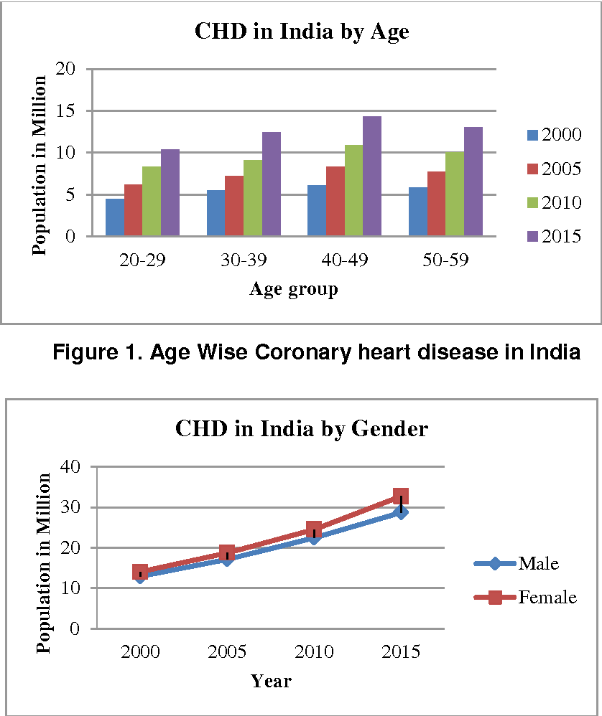
GRAPH

Slide 10
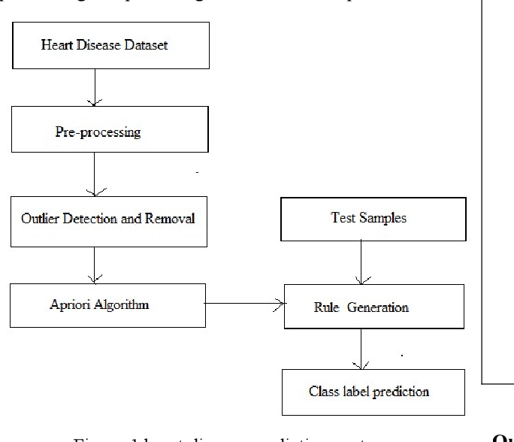
Implementation :-

Slide 11
Summary:-
Risk factors include high blood pressure, high cholesterol, smoking, obesity, and a sedentary lifestyle. Symptoms vary but may include chest pain, shortness of breath, fatigue, and palpitations. Diagnosis involves medical history, physical exams, imaging tests, and blood tests. Treatment ranges from lifestyle changes and medications to surgical interventions, emphasizing early detection and management for improved outcomes.

Slide 12
Conclusion :-
heart diseases represent a significant global health challenge, encompassing various conditions with diverse risk factors and symptoms. Timely diagnosis, effective management, and preventive measures are vital in addressing this issue. Promoting heart-healthy lifestyles, early detection through regular screenings, and advancements in medical interventions are key strategies in reducing the burden of heart diseases and improving overall cardiac health. Continued research and public health initiatives are essential in combating this leading cause of morbidity and mortality worldwide.

Slide 13


